Slide 1

YouAnalytics
K.M.A.R.T. consulting
KRISSY STICHNOTE, MORGAN COPELAND, AUSTIN MCCOWAN, RAYMOND CHITAURO, TYRONE BERRY

Slide 2
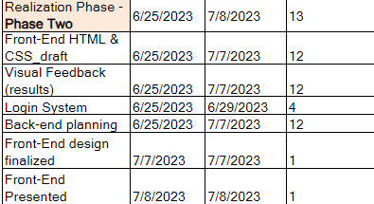
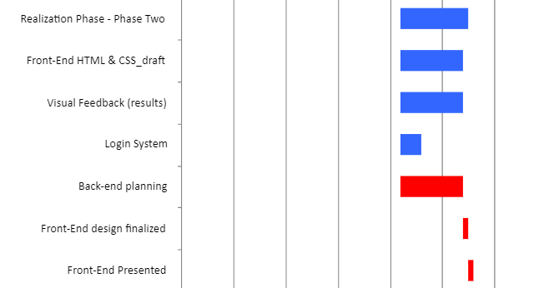
Realization Phase - Phase two
Krissy, Project Manager
Timeline Update:
During Phase Two we developed the front-end of our application.
What you will see today
User interface of system
Ways of interaction with system
Login System
System Architecture

Slide 3
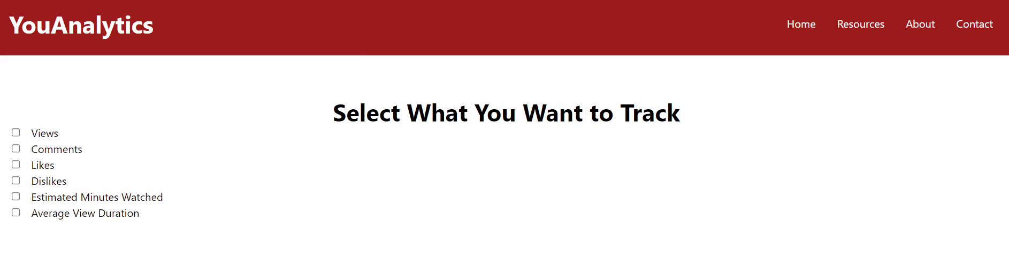
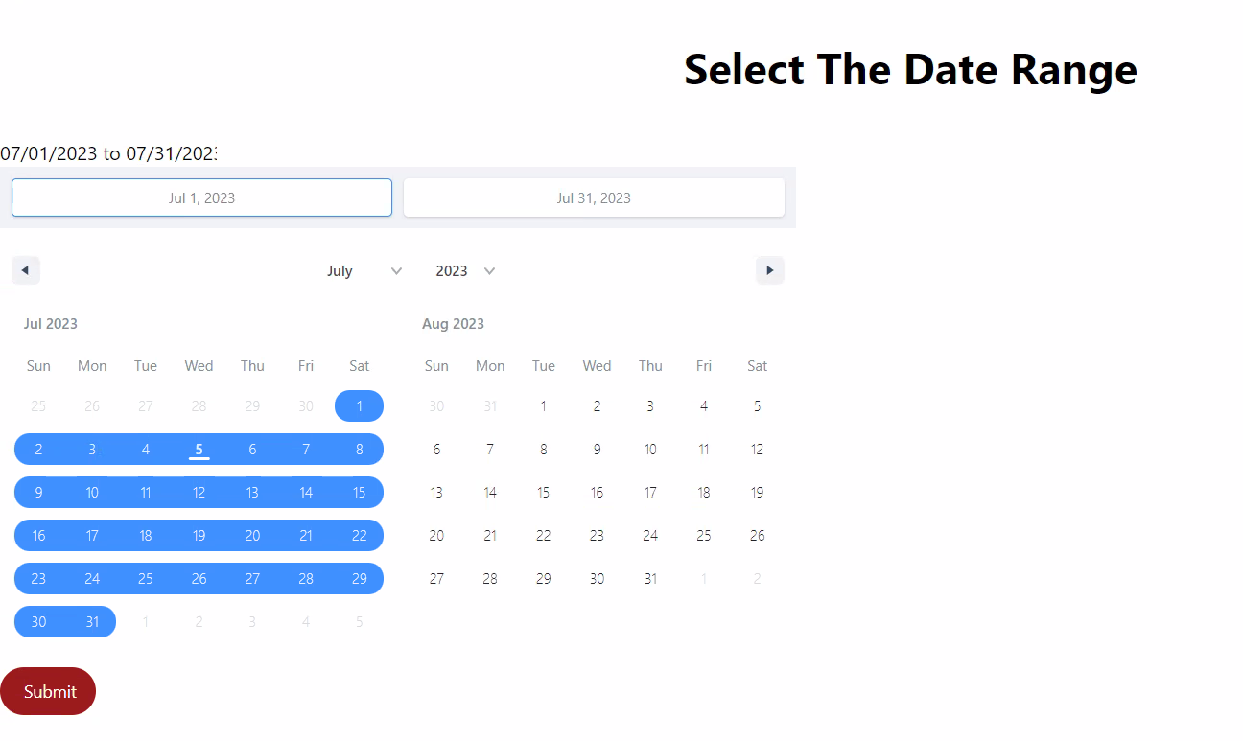
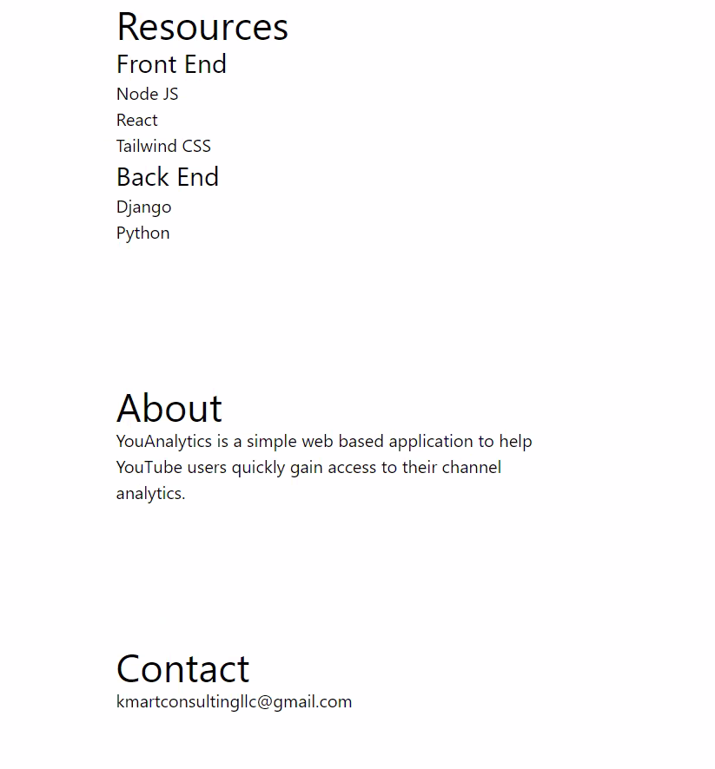
Client Side (Front–End) Tyrone, Developer
YouAnalytics is a tool that is used for quick and simple access to information you want to track as a YouTube User.
Easily select what data you want track:
Views
Likes
Dislikes
Estimated Minutes Watched
Average View Duration
Date Range
Front-End Resources:
Node JS
React
Tailwind CSS

Slide 4
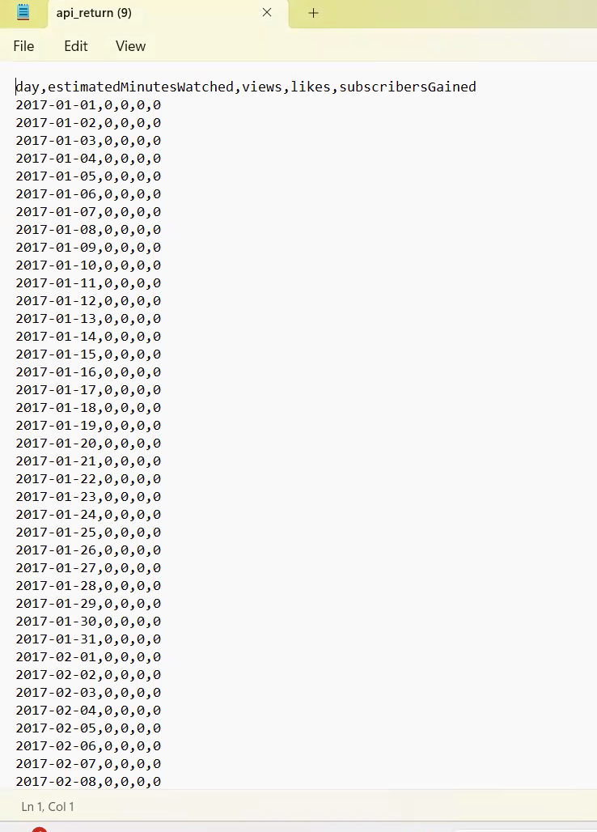
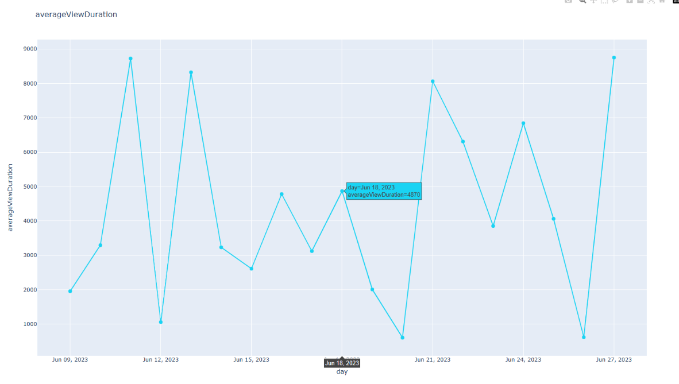
Visual Outputs Tyrone, Developer
The data from YouAnalytics will be returned in a CSV flat file.
We will be furthering the output of the results by providing a visual feedback, like the chart below.

Slide 5
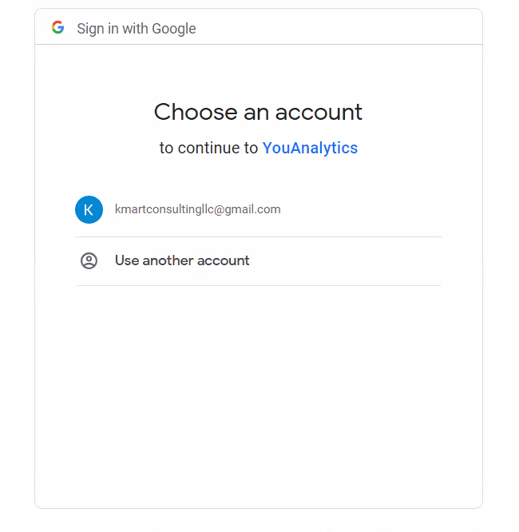
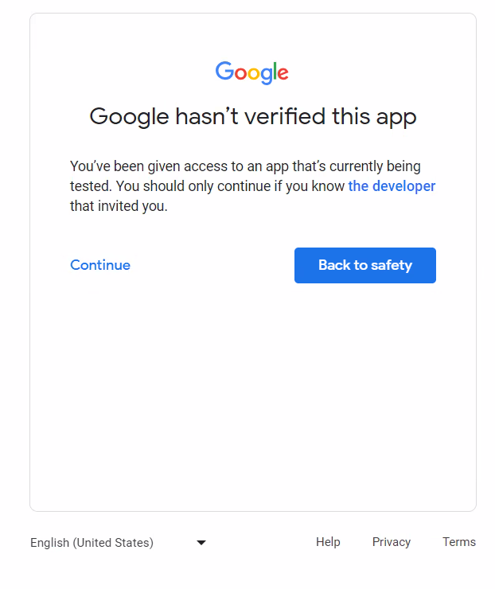
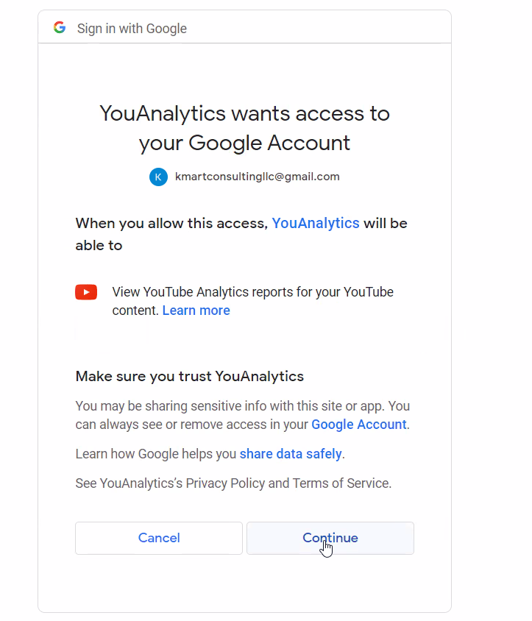
Login system Austin, Developer
YouAnalytics will use Google Authentication Services API.
This API will:
Verify who a users is
Enable access to a user’s confidential YouTube account information.
Note: None of the user’s personal information will be hosted locally, no need to secure that information.

Slide 6

System Architecture Morgan, developer
Django
HTML
Tailwind CSS
React JavaScript
Google YouTube Analytics API
Google OAuth 2.0

Slide 7

Thank You
K.M.A.R.T. Consulting
Krissy stichnote
Morgan copeland
Austin mccowan
Raymond chitauro
Tyrone berry

